Slide 1

Patient Health Tracking System
SURE ProEd
SAGAR K
COURSE : EMBEDDED SYSTEMS AND IOT
MENTOR : MEHAK MAJEED

Slide 2
Contents
Introduction
Objectives
Components
General Block Diagram
Methodology
Protocols
Working Hardware Setup
Limitations of the Patient Health Monitoring Prototype
Application
Future Scope

Slide 3
Introduction
Input From the Sensors
01
Data Processing
02
Central Processor
ESP32 S3
03
Threshold Checking / Emergency Detection
Output the Data
04
Communication
/Connectivity
05

Slide 4
Objectives
Design and implement a portable system to measure heart rate and SpO₂.
Integrate an accelerometer for automatic detection of falls.
Implement emergency communication via GSM (SMS + Call).
Attach location information using GPS coordinates and Google Maps link in SMS.
Display vitals and alerts on an OLED display in real time.
Ensure low power consumption by updating display only when vital changes occur.

Slide 5
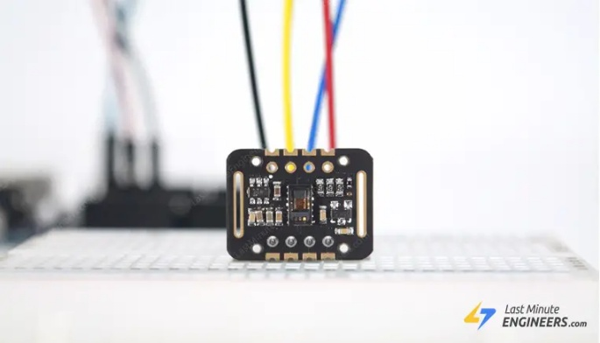
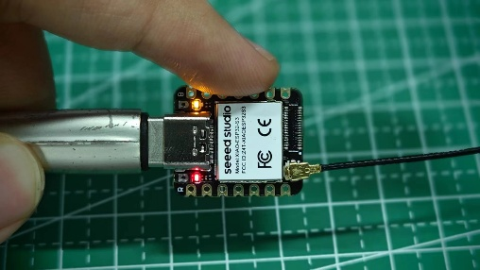
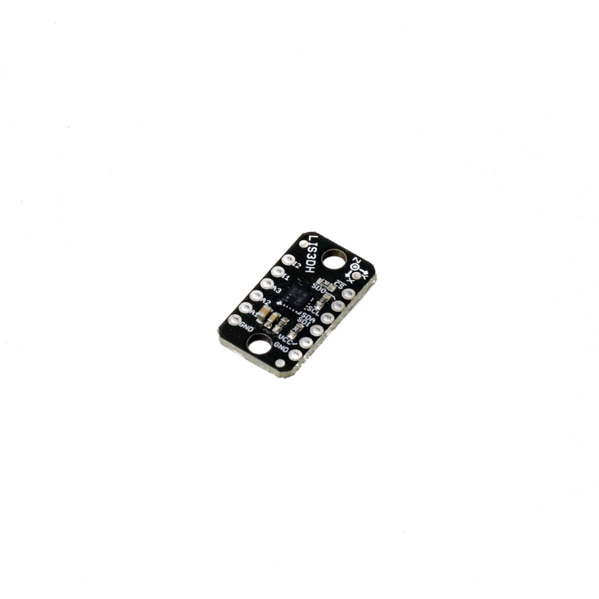
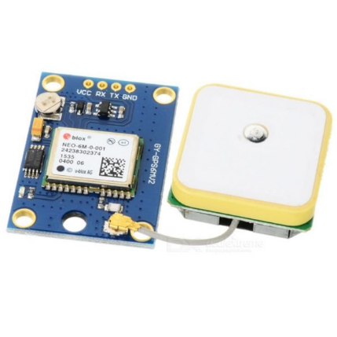
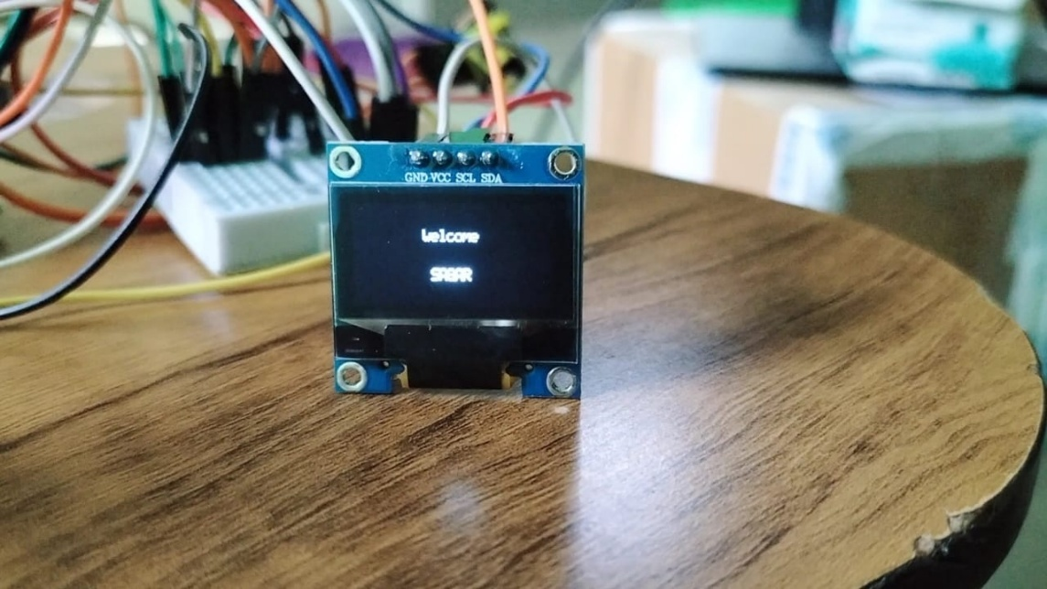
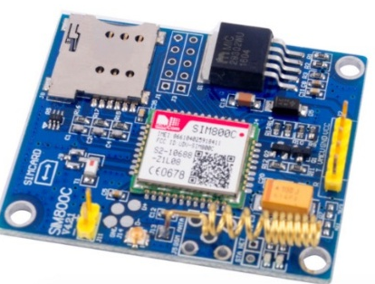
Components
Seeed XIAO ESP32S3 Sense
LIS3DH Accelerometer
MAX30102 Heart-Rate and SpO₂ Sensor
NEO-6M GPS (Global Positioning System) Module
(Organic Light Emitting Diode) OLED DISPLAY
SIM800C GSM (Global System for Mobile Communication) Module

Slide 6
General Block Diagram
Accelerometer
GSM Module
SMS
ESP 32
MICROCONTROLLER
MAX30102 SENSOR
NEO-6M GPS Module
HEART RATE
LOCATION
SPO2
Accelerometer
LIS3DH Accelerometer
NEO-6M GPS Module
ACCELEROMETER SENSOR
REAL TIME LOCATION
OLED display

Slide 7
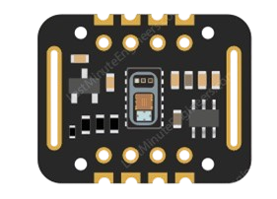
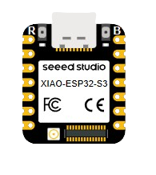
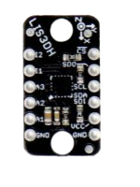
Methodology of Two-Wire I2C Sensor Communication
Figure: Connections between ESP32-S3, MAX30102, and LIS3DH sensors.

Slide 8









Methodology of Two-Wire I2C Sensor Communication
Enter main while-loop to continuously acquire sensor data.
Apply algorithms to interpret MAX30102 readings to calculate metrics like heart rate or SpO2.
Initialize two different I2C interfaces to allow simultaneous communication with two sensors.
Initialize LIS3DH sensor via WireACC; verify sensor presence and set accelerometer range.
START CONTINUOUS DATA ACQUISITION LOOP
LIS3DH SENSOR INITIALIZATION AND CONFIGURATION
DATA PROCESSING AND ANALYSIS
MICROCONTROLLER INITIALIZATION
SYSTEM POWER-UP
MAX30102 SENSOR INITIALIZATION AND CONFIGURATION
SENSOR WARM-UP AND CALIBRATION
DISPLAY OR TRANSMIT DATA
POLL MAX30102 FOR NEW DATA (WIREMAX)
ESP32S3 powers up, starts internal system clock.
Update user display, or log data for monitoring.
Initialize MAX30102 sensor via WireMAX; verify sensor presence and configure parameters
Perform sensor warm-up period to stabilize readings.
Read accelerometer data from LIS3DH via WireACC.
Process or buffer accelerometer readings as needed.

Slide 9
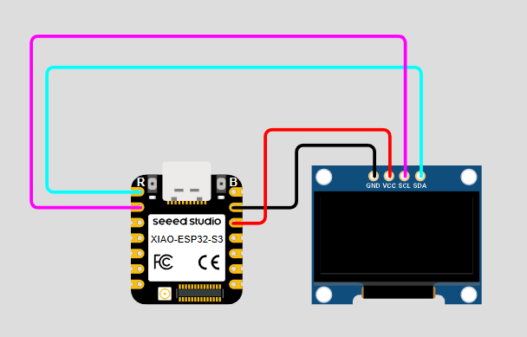
Methodology of I²C Bit-Banging (OLED Display)
Figure: ESp32 S3 and Oled Display connection

Slide 10
Methodology of I²C Bit-Banging (OLED Display)
2
IMPLEMENT TIMING DELAY
This controls the speed of the bit-bang signals.
CONFIGURE PINS
GENERATE START CONDITION
1
Define two GPIO pins: one for SDA (data line), one for SCL (clock line).
While SCL is HIGH, pull SDA from HIGH to LOW to begin communication.
3
I²C Bit-Banging (OLED Display)
WRITE CONTENT/UPDATE DISPLAY
SEND BYTE DATA BIT-BY-BIT
6
4
Use the bit-bang send process to write data bytes corresponding to pixels
For each bit (starting with most significant bit), set SDA HIGH or LOW.
ACKNOWLEDGMENT, STOP & SEND COMMANDS
Send initialization commands over bit-banged I²C
5

Slide 11
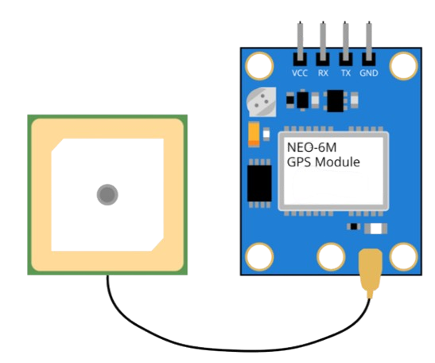
Methodology Of GPS Module Communication
Figure: ESp32 S3 and GPS Module connection

Slide 12




Methodology Of GPS Module Communication
Loop Continuation
Hardware Connection
print GPS information (coordinates, time, satellites) to the serial monitor for debugging.
Repeat reading from UART, parsing, and monitoring continuously in the main loop.
Connect the GPS module’s TX pin to the ESP32’s RX pin (GPIO44).
Connect the GPS module’s RX pin to the ESP32’s TX pin (GPIO43).
GPS MODULE COMMUNICATION
Using GPS Data
UART Initialization
The system uses this GPS data to create location-tagged messages in case of emergency.
Latitude, longitude, date, time (converted to IST) are formatted into SMS messages.
Initialize UART2 at 9600 baud (standard GPS baud rate), 8 data bits, no parity, 1 stop bit.
Receiving Raw GPS Data
Check for Valid GPS Fix
Continuously read incoming ASCII bytes from UART2, which represent NMEA sentences output by the GPS module.
Extracting Meaningful Information
Verify if the parsed latitude and longitude data are valid (i.e., the GPS module has a fix).
If valid, these coordinates can be used or transmitted further.
Once a complete and valid sentence is parsed,

Slide 13






Methodology Of GSM Module Communication
System Initialization
Continuous Monitoring
Triggering Emergency Alert
Sending SMS Alert
Making Emergency Call
Post-Alert Handling

Slide 14


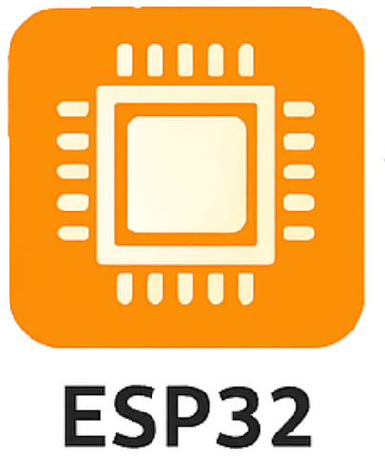


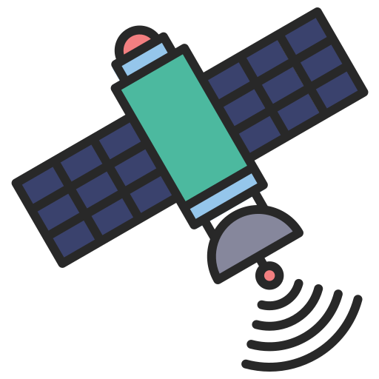


Protocols
MAX30102
(Heart rate & SPO2 )
LIS3DH Sensor
I²C Protocol
I²C Protocol
NMEA (National Marine Electronics Association) protocol
UART Protocol
I²C ( Bit-banged )
Neo 6M GPS Module
UART Protocol
Oled Display
Satellite
GSM Module
Tower
AT Commands

Slide 15
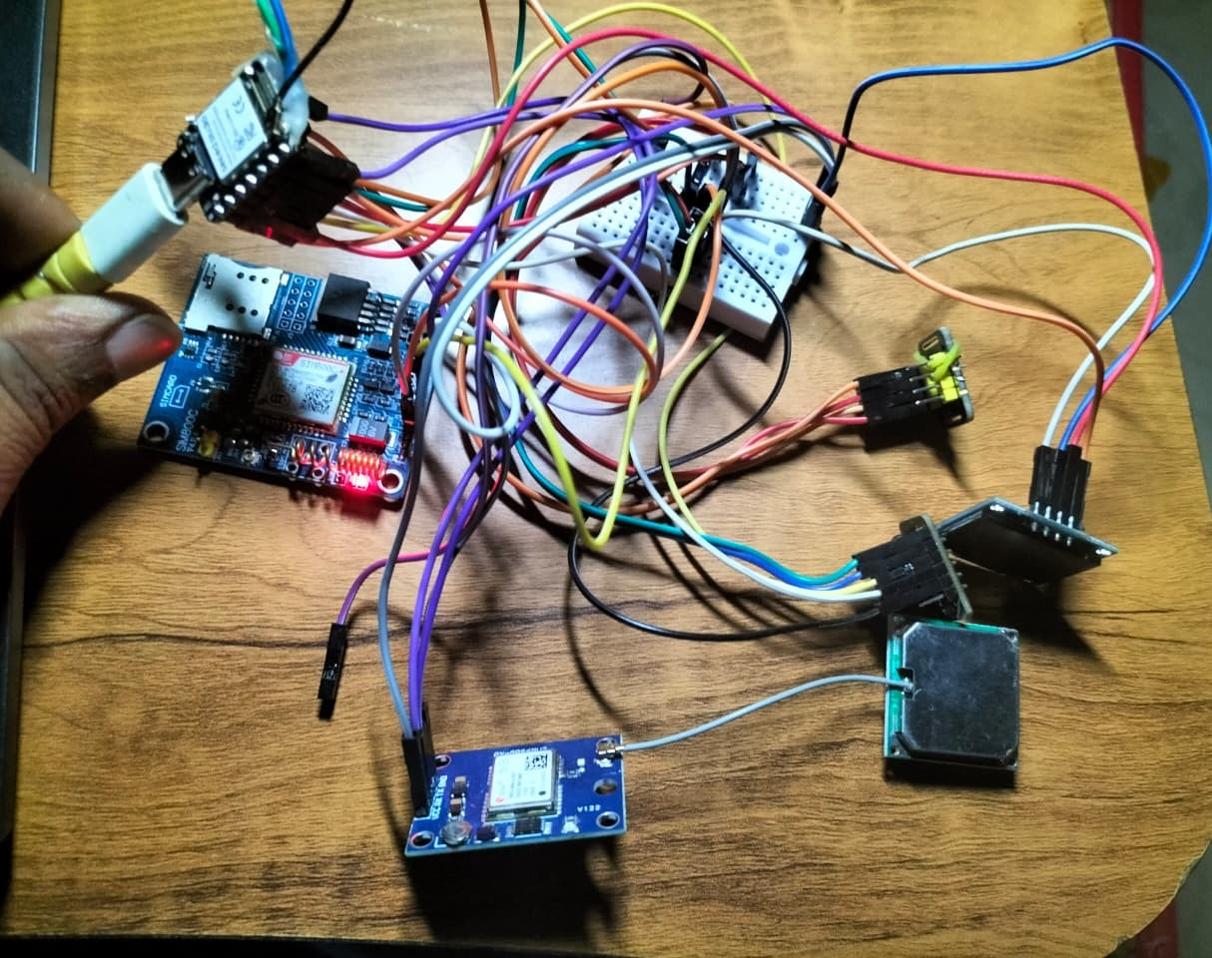
Working Harware Setup
ESP32S3
MAX30102 sensor
GSM Module
ACCELERATOR Module
Oled Display
GPS Module
Figure: Working Model of Patient Health Tracking System

Slide 16








Limitations of the Patient Health Monitoring Prototype
Sensor Accuracy
Cellular Dependence
Motion artifacts or improper contact affect MAX30105/LIS3DH,
requiring calibration for reliable data.
No signal means no SIM800C alerts, directly impacting timely
emergency communication.
Fall Detection
Limited User Interface
Simple acceleration thresholds risk false positives (sudden movement)
or false negatives (slow falls).
Small OLED restricts interaction and feedback,
creating accessibility issues for some users.
Power Consumption
Contact Flexibility
Continuous operation (sensors, OLED, GPS, SIM800C) drains battery
quickly, limiting device uptime.
Hardcoded contacts lack dynamic management. No wireless fallback impacts
communication in outages.
GPS Availability
Scalability
Indoor or dense areas degrade GPS signals, impacting emergency
location reliability and alert delivery.
Hardware and code complexity can hinder adding features
leading to performance bottlenecks.

Slide 17
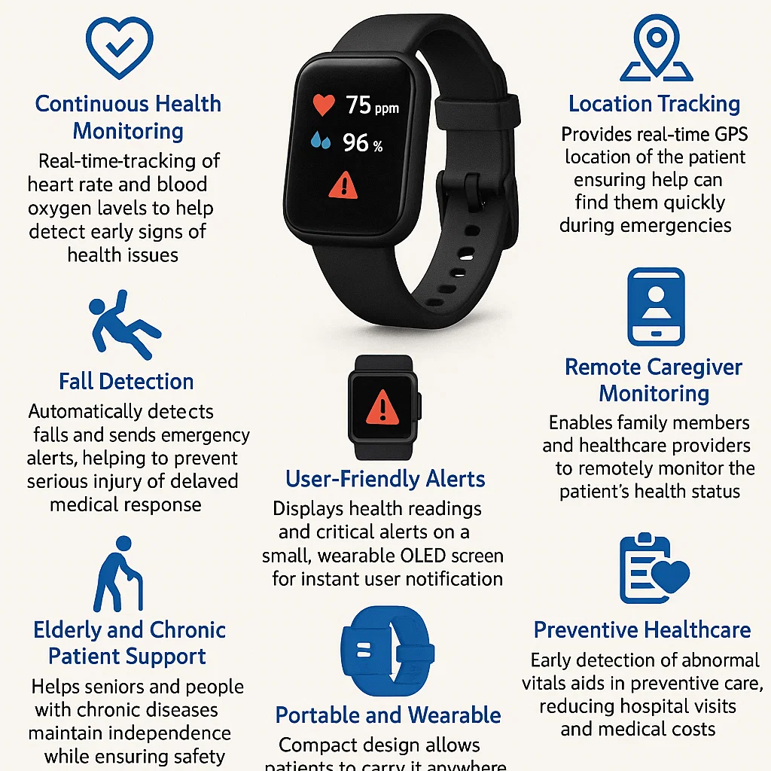
Application

Slide 18
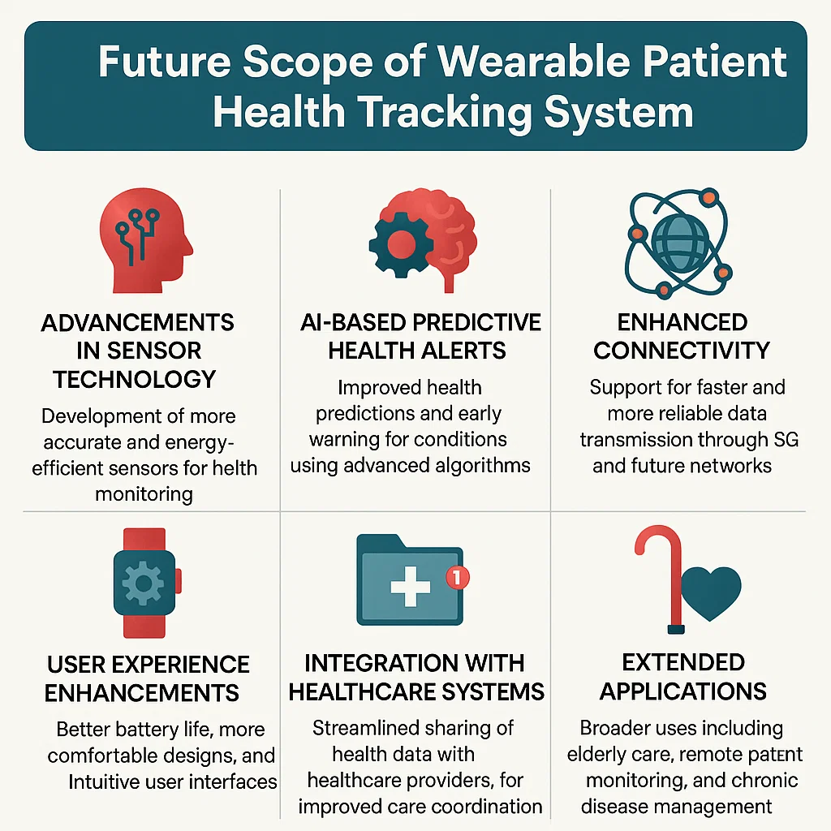
Future Scope
Advancements in Sensor Technology
AI-Based Predictive Health Alerts
Enhanced Connectivity
User Experience Enhancements
Integration with Healthcare Systems
Extended Applications

Slide 19


